Slide 1
Grant Activity Report
Friends of Brazoria Wildlife Refuges
Board of Directors Meeting
Friday, December 4, 2015
Discovery Center
By Marty Cornell

Slide 2
Two Decades of FOBWR Grants
Includes Matching Funds. In-Kind Value Not Included.
96
97
98
99
00
01
02
03
04
05
06
07
08
09
10
11
12
13
14
15
16

Slide 3
FOBWR Grants by $ Spent, 1996 – 2015 (55 Grants)
$162,729
$75,604
$103,575
<$5,001, 22 grants (8 NFWF)
$138,826
$5,001 to $10,000, 13 grants (1 NFWF)
$430,777
$10,001 to $50,000, 14 grants (1 NFWF)
$50,001 to $100,000, 2 grants
$139,535
$1,260,000
>$100,000, 5 grants
Matching cash
In-kind value

Slide 4
FOBWR Grants by % Total Spent, 1996 – 2015 (55 Grants)
3.3%
4.5%
<$5,001, 22 grants (8 NFWF)
7.0%
$5,001 to $10,000, 13 grants (1 NFWF)
6.0%
18.6%
$10,001 to $50,000, 14 grants (1 NFWF)
6.0%
$50,001 to $100,000, 2 grants
54.5%
7.9%
>$100,000, 5 grants
Matching cash
In-kind value

Slide 5
Use of FOBWR Grant Funds, 1996 – Jan. 2016
0.4%
12.9%
12.9%
Capital Facilities $ 892,080
(Trails, Boardwalks, Pavilions)
Pre-Land Acquisition $ 900,000
Environmental Education $ 119,591
Science & Surveys $ 9,300
Land Restoration $ 285,000
Total $2,205,791
40.4%
40.8%
(In-kind value not included)

Slide 6
Completed Grants
During 2015
20100909 Discovery Center Displays (USFWS R2 CCS, $20,000 + FOBWR match + $30,000)
20150405 Birds-of-Prey MC15 (Phillips 66 Corporate, $10,000)
20130915 Land Acquisition Discovery #2 a.k.a Houston Endowment. ($300,000)

Slide 7
Active Grants of Friends of Brazoria Wildlife Refuges 4Dec15
20091123 Dow Woods Trail (Bastrop Bayou Crossing)
20130201 Bastrop Bayou Crossing ($70,000)
20130919 Trull Foundation toward Purchase of Poole Tract ($10,000)
20140901 Houston Urban Native Garden ($18,000, USFWS Region 2 Cooperative Agreement Award).

Slide 8
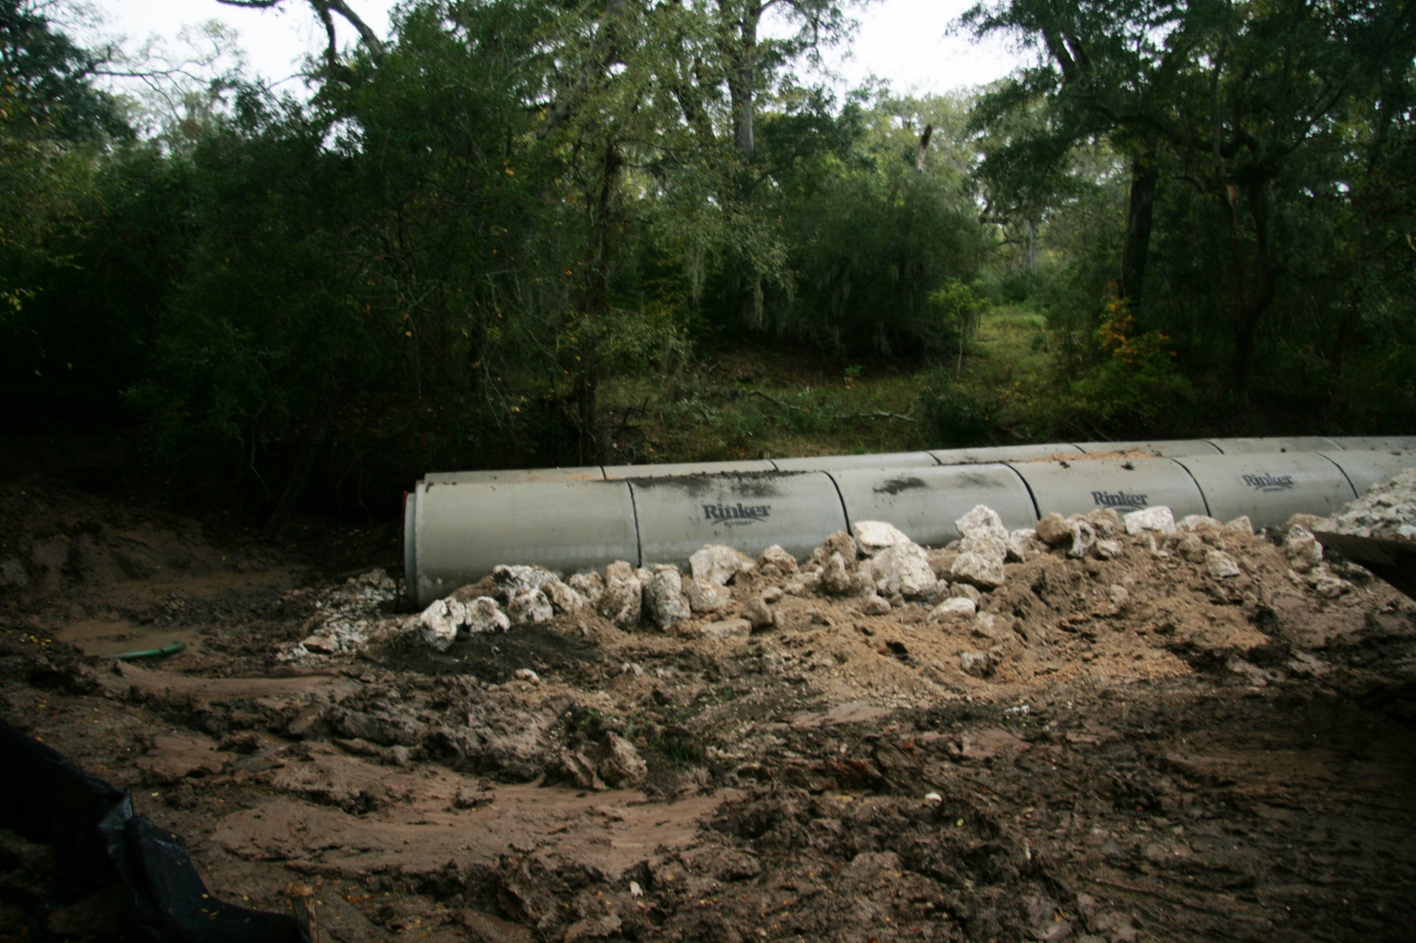
22 Nov13

Slide 9
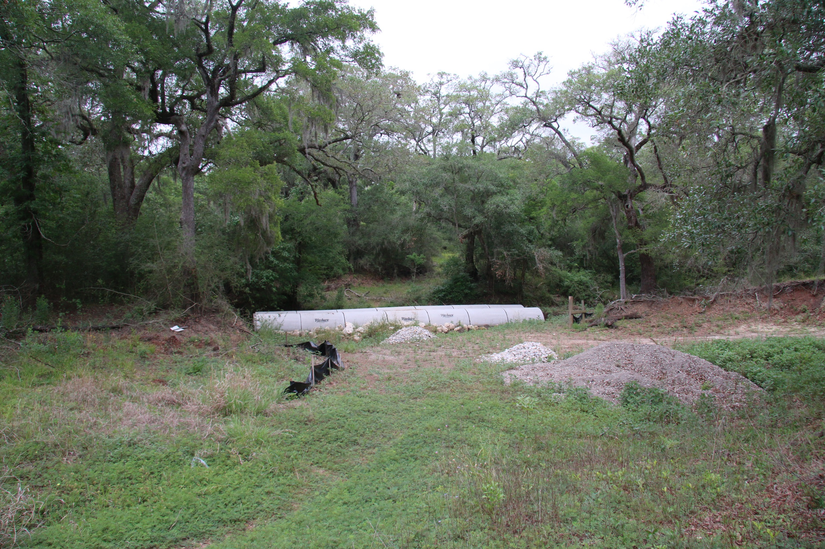
26 May 14

Slide 10
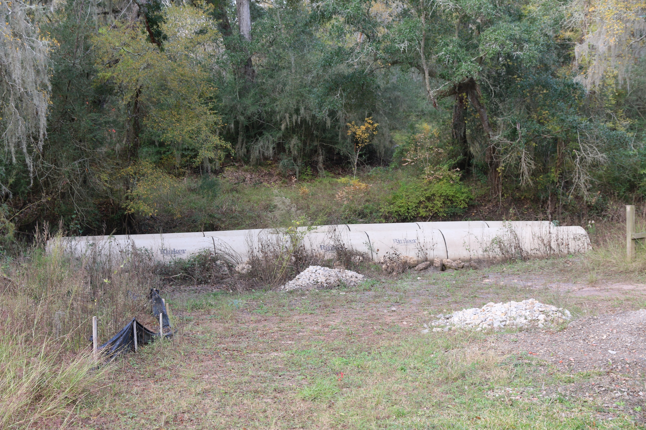
30 Nov 14

Slide 11
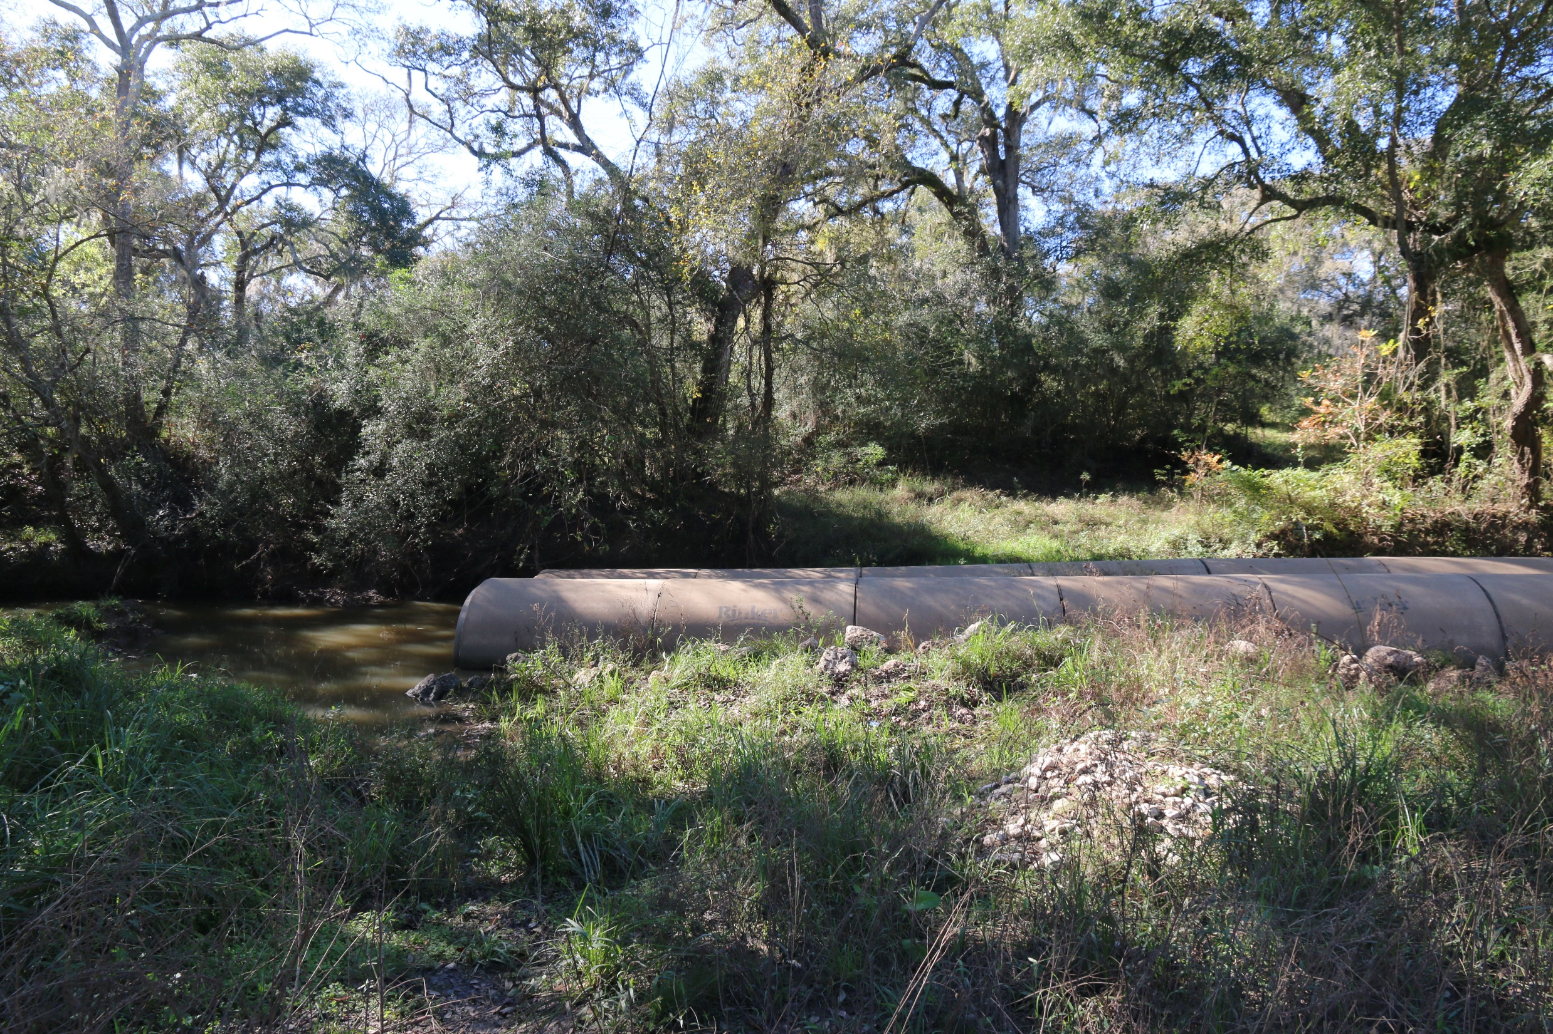
4 Dec 15

Slide 12
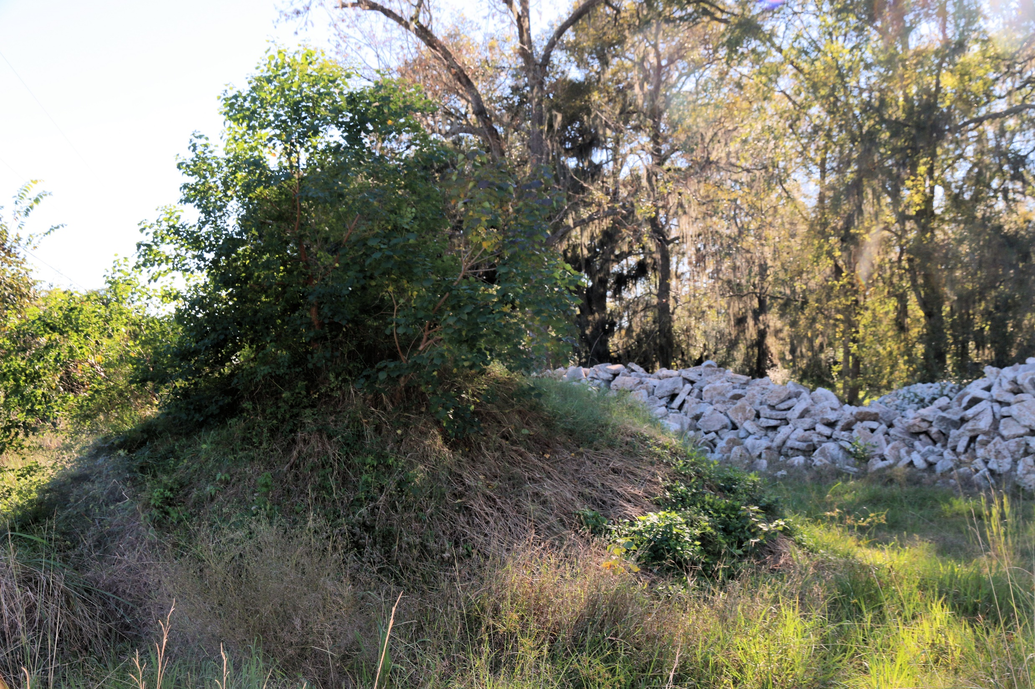
4 Dec 15

Slide 13
4 Dec 15

Slide 14
Marty:
Thanks for your e-mail on the last remaining Poole lot located within the northeast corner of the boundary of the, about 9-acres, which was not in the Family partition agreement and all the Poole Family about 8 members hold a undivided interest in this tract.
We contracted a market value appraisal report on this tract with fee appraiser Barry Coleman with market value of about $32,000. One of the Poole family members, a Mr. Barbour, has now died and he did not pay his 1/8 interest on the taxes. Brazoria County has now taken title to this undivided interest per tax forclosure. The Poole Family representative, LIz Taylor, is working with FWS Realty Specialist Nancy Unbehaun on this title issue. The Poole Family have accepted the total appraised value offer but the remaining family members must pay the county for the Barbour interest before we can close the purchase
We are asking Nancy for updated status of this important remaining land purchase. She sure has spend a great deal of time and effort on the Poole Family members, that are elderly and scattered all over the United States!
Regards
Tom Smith,
Land Consultant (NFWF) Fri 12/4/2015 11:53 AM

Slide 15
Houston Urban Native Gardens
Friends #20140901
$18,000 Awarded
$13,412 Spent (30Nov15)
$4,488 remaining.
“Remaining funds will be utilized for renting a chipper to remove invasive trees at the Ley Plaza Garden, purchasing interpretive panels and plants for a demonstration garden at the J.D. Robson Community Center near Herman Park.” Jennifer Sanchez

Slide 16
Pending Grants of Friends of Brazoria Wildlife Refuges 4Dec15
Bobcat Woods Trail Extension (TPWD Recreational Trails Program, $160,000 + $40,000 match)
Notified on 15Jun15 “selected to receive” grant.
Pending sanction from TDOT, Texas Historical Commission, TPWD Wildlife Habitat Assessment, & Federal Highway Administration…
… and site visit by Trey Cooksey of TPWD, RT Program Manager
3rd Pre-acquisition Discovery) (Houston Endowment, $300,000, 1Q16

Slide 17
Friends Grant Archive on Web Site.
To view the Grant Tracking site index:
http://refugefriends.org/Grant_Tracking/

