Slide 1
Friends of Brazoria Wildlife Refuges
Board of Directors
Talented, experienced professionals
Self-motivated
Focused on supporting objectives of TMCNWRC
Effective management of grants.
Respectable fund raising, blessed by McGovern.
Support refuge environmental education.
Effective engagement of our community
Migration Celebration
Birds-of-Prey
Outreach, e.g. Houston Urban Initiative

Slide 2
Friends of Brazoria Wildlife Refuges
Board of Directors
? Succession Planning?
? Burn out?
? Talent to fit needs?
? Fiduciary Responsibility?
? Diversity?
? Governance?

Slide 3
Nurturing and Improving our Friends Board
Concepts from:
Region 2 Peer-to-Peer Workshop, Bosque del Apache NWR, September 5-7, 2014
Friends Mentor Workshop, NCTC, October 29 – November 2, 2014
Marty Cornell 16Dec14

Slide 4
Board Development and Management for Nonprofit Friends Groups
Peer-to-Peer Workshop
September 6, 2014
Cathy Allen

Slide 5
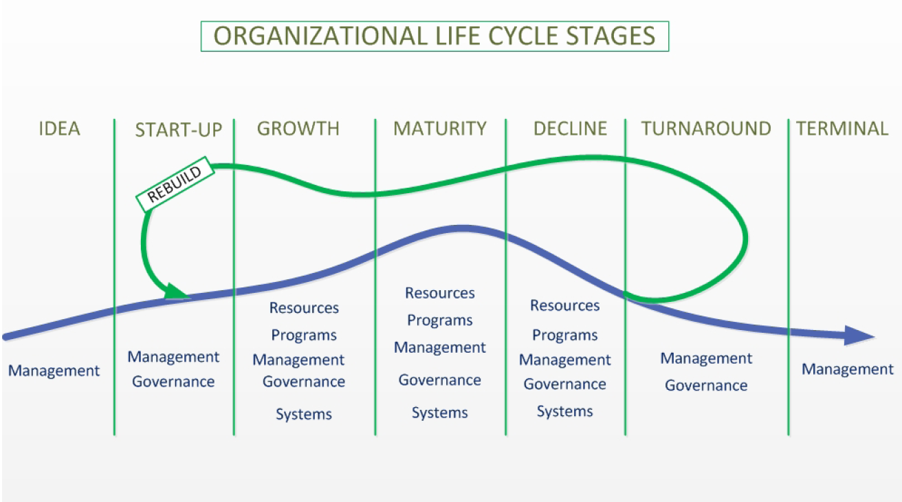

Slide 6
Keep your Eye on the Prize
Mission
Strategy

Slide 7
What’s the Mission and Strategy of the Friends of Brazoria Wildlife Refuges?

Slide 8
Separate Ends and Means
An effectively-operating board is not an end in and of itself, but rather a means for achieving some end.
What is the purpose? What could we achieve with more board involvement? What is our mission?
Cathy Allen

Slide 9
Board Governance
Mission and Vision
Bylaws and Other Governance Policies
Board Role and Responsibilities
Board and Committee Structure
Board Culture and Group Dynamics
Board Composition and Development
Meetings
Cathy Allen

Slide 10
Modern Boards Operate in Three Modes
Fiduciary
Strategic Generative
Cathy Allen

Slide 11
Just what should board members be engaged in?
Fiduciary Mode
Budgeting and oversight
Financial health and sustainability [fundraising]
Evaluation
Strategic Mode
Planning
Generative Mode
Mission/Vision/Values
Policy
[Advocacy]
Cathy Allen

Slide 12
Invest Time in Recruitment and Orientation
Make sure each board prospect knows what you value about them.
Recruit people who are self-motivated.
Board member position description
Spell out expectations
Provide new board members with:
Materials (minutes, financials, policies, etc.)
Time to introduce themselves
Space to ask questions
Cathy Allen

Slide 13
Board Composition and Development
Strong CEO’s want strong boards (strong refuge managers should want them too!)
A board should be well-rounded for skills, experience, and connections needed for the organization’s unique purpose.
Diversity in age, gender, race, geography, economics, stakeholder interests.
Commitment to organization – willing to govern (take care of the golden goose)
All important roles should be covered – filling gaps is a priority.
Cathy Allen

Slide 14
Recruitment Matrix
 | Board Service | Social Media | Grant-Writing | Knows birds
Bob | X |  |  | X
Sue
Mary |  |  | X | X
Joe | X |  | X | X
Beth |  |  |  | X
Cathy Allen

Slide 15
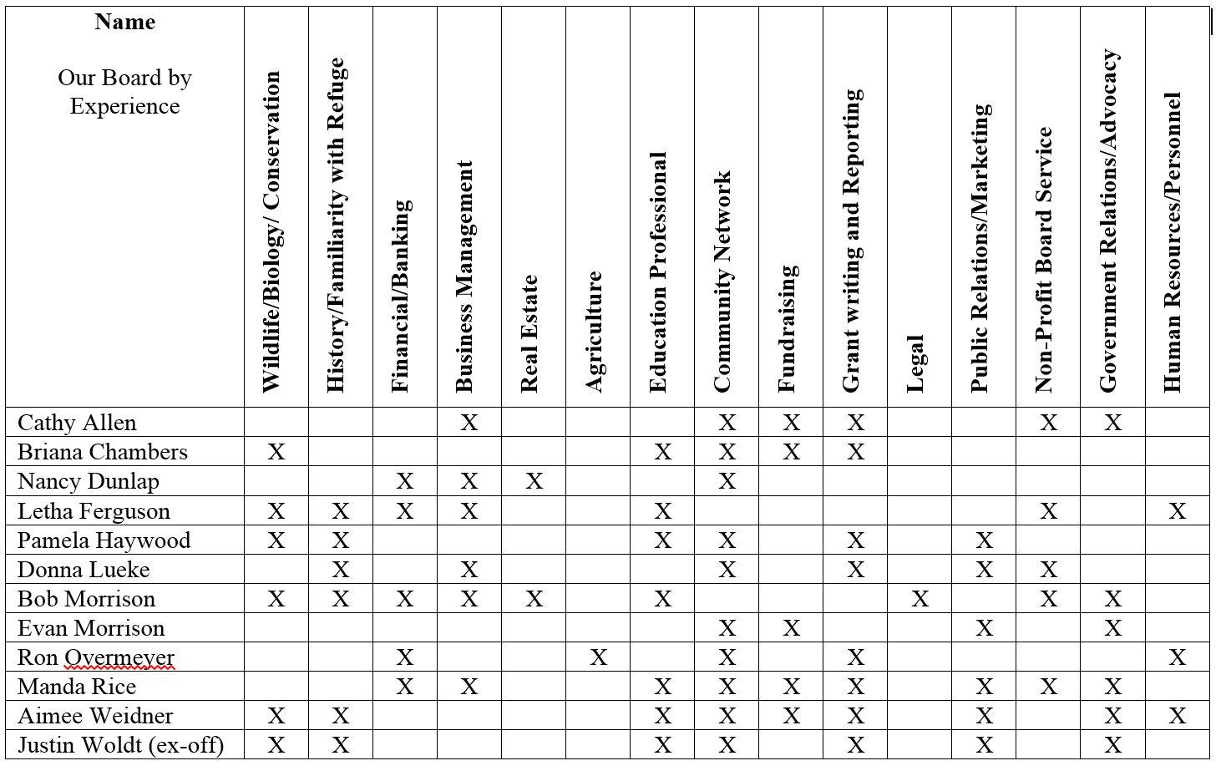
Ottawa National Wildlife Refuge Association
Revised Board Matrix
March 2014

Slide 16
FOBWR Board Development.
Next Steps?
A board should be well-rounded for skills, experience, and connections needed for the organization’s unique purpose.
Mission

Slide 17
A Mission is:
A statement of “Who”
A statement of “Why”
A statement of “Where”
A Mission is not:
A statement of “How”
A statement of “When”
}
This is Strategy

Slide 18
Our mission is to support, complete, and enhance the Balcones Canyonlands National Wildlife Refuge and its diverse ecology and promote its use for recreational, educational, and scientific purposes. Founded in 2002, Friends of Balcones is a 501.c.3 tax-exempt corporation. Headquartered in Lago Vista, Texas, the Friends organization has about 200 members and numerous volunteer-led programs and activities. We are governed by a seven-person Board of Directors and work closely with refuge staff to accomplish our mission

Slide 19
Our mission is to support, complete, and enhance the Balcones Canyonlands National Wildlife Refuge and its diverse ecology and promote its use for recreational, educational, and scientific purposes. Founded in 2002, Friends of Balcones is a 501.c.3 tax-exempt corporation. Headquartered in Lago Vista, Texas, the Friends organization has about 200 members and numerous volunteer-led programs and activities. We are governed by a seven-person Board of Directors and work closely with refuge staff to accomplish our mission

Slide 20
“Ding” Darling Wildlife Society, the non-profit Friends of the Refuge organization, supports environmental education, services, and land conservation at the J.N. “Ding” Darling National Wildlife Refuge Complex. Education and conservation efforts may extend beyond the complex’s borders. We partner in these efforts where possible with like-minded conservation organizations. - See more at: http://dingdarlingsociety.org/article95.htm#sthash.yNeIRL05.dpuf

Slide 21
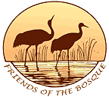
The Friends of the Bosque del Apache National Wildlife Refuge work on behalf of birds and wildlife, helping to protect the critically important habitat of the Bosque del Apache National Wildlife Refuge, and helping to educate and inform the public about the value and beauty of all life at the Bosque.

Slide 22
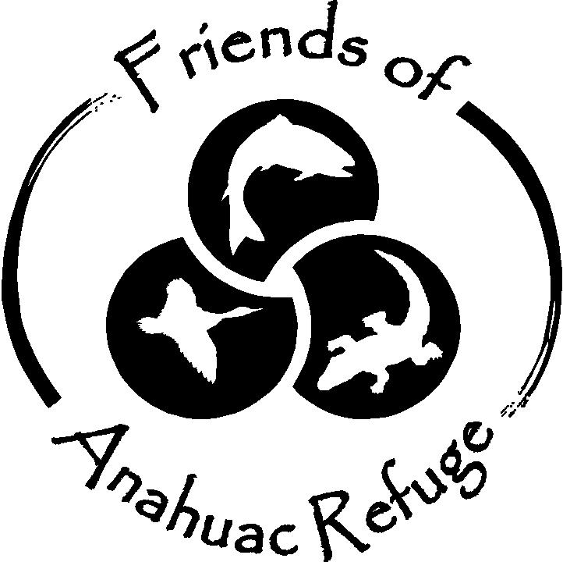
The Friends of Anahuac Refuge (FOAR) is a volunteer run, 501(c)(3) non-profit, advocacy organization supporting Anahuac National Wildlife Refuge. The Friends have contributed tens of thousands of volunteers hours to the refuge and have completed numerous projects over the years. Since being established in 1997, the Friends has served as a link between the refuge and community. Our members range from local residents who regularly visit the refuge to travelers from all over the world who come to see the refuge.

Slide 23
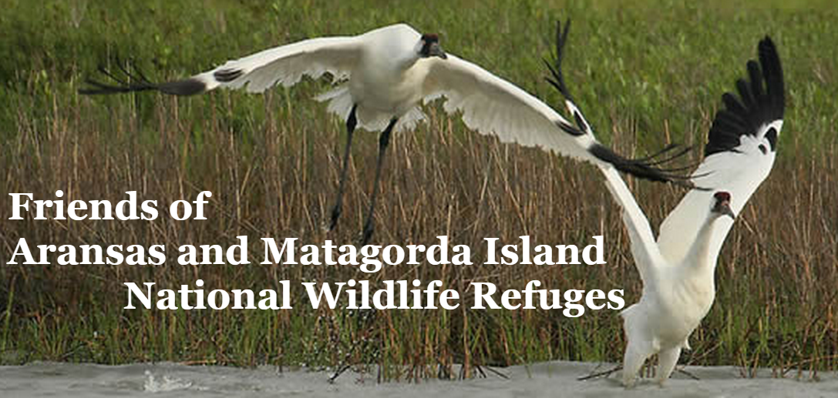
The Friends of Aransas & Matagorda Island National Wildlife Refuge (FAMI) are dedicated to supporting and assisting the refuge in its goal of enhancing wildlife and its habitat and encouraging compatible wildlife dependent public uses of the refuge through educational, interpretive, scientific and other means appropriate to the mission of the refuge.

Slide 24
FOBWR Board Development.
Next Steps?
Mission
Develop Board Skill Matrix

Slide 25
Draft Example
Recruitment Matrix
Friends of Brazoria Wildlife Refuges, Board of Directors
Needed Skills --> | Enjoyment of Nature | Board Experience | Organization Management | Networked with Business, and Political Communities | Networked with NGO Community | Accounting / Financial | Legal | Grant Writing | Fundraising | Youth Education | Construction / Civil Engineering | Social Media | Public Relations - Marketing
Ed Barrios | X | X
Ron Bisbee | X | X
Marty Cornell | X | X | X |  | X |  |  | X | X | x |  |  | X
Mickey Dufilho | X | X
Phil Huxford | X | X
Jeanne Manry | X | X
Neal McLain | X | X
Tom Morris | X
David Plunkett | X | X
Dick Schaffhausen | X | X
Tom Taroni | X | X
Torry Tvedt | X | X

