Slide 1
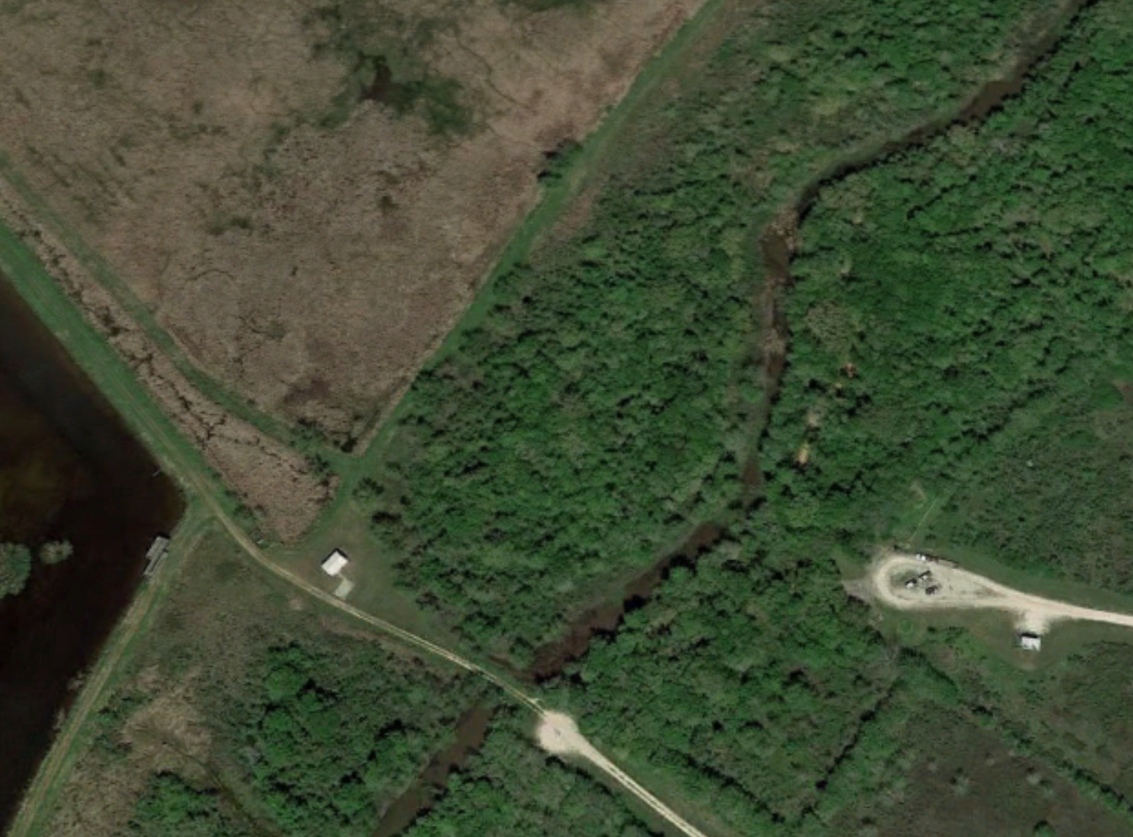
Bobcat Woods Loop Trail
San Bernard National Wildlife Refuge
Brazoria County, Texas
Cocklebur Slough
Concrete Sections
Sections of New Boardwalk
Wolfweed Lake
Gravel Spur
Water Well
Parking Lot
Observation Platform
Pavilion
Path of Existing Boardwalk
Restrooms

